Slide 1
Presentations and Debates
Class 2 · Topics on the Italian Economy
MGMTEX 421 · International Business Residential in Italy
Prof. Nico Voigtländer · UCLA Anderson
Notes:
Welcome back. This is our second class, and today the class is yours: 9 groups present, and we debate. Two broad-topic debates and five of the companies we will visit in Milan and Turin. I will keep time and moderate, and we close by looking ahead to the trip itself.

Slide 2
Italy IBR · Today’s Roadmap
Class Today: Your Presentations and Debates
1
Logistics – the schedule from here
2
Arrival in Milan – a quick poll
3
9 group presentations – in order of group number
International Business Residential – Italy
2
Notes:
Here is the plan. First the logistics from here to Milan, then a quick poll on when you arrive, and then the main event: the 9 group presentations. Two of them are head-to-head debates on broad questions about the Italian economy, and five are company presentations on firms we will actually walk into during the trip.

Slide 3
Italy IBR · Course Logistics
Logistics – The Schedule from Here
Class today: discussion of the presentation debates
Present a 2 – 3 min executive summary
Followed by discussion
Max. 20 minutes per topic
Trip to Italy: Sep 6 – 11 – Milan & Turin (Schedule)
Note: casual dress code
Get melatonin for the jetlag!
Class on Oct 4: debrief and discussion of student reports
International Business Residential – Italy
3
Notes:
Three things on timing. Today each group gives a 2 to 3 minute executive summary of the video you already submitted, and then we open it up; I will cap each topic at 20 minutes so everyone gets the floor. The trip runs September 6 to 11, Milan first and then Turin, with flights home on Saturday the 12th. The full day-by-day schedule is on the last slide if you click through. Dress code is casual throughout, and do get melatonin before you fly. We meet once more on October 4 to debrief and talk through your reports.

Slide 4
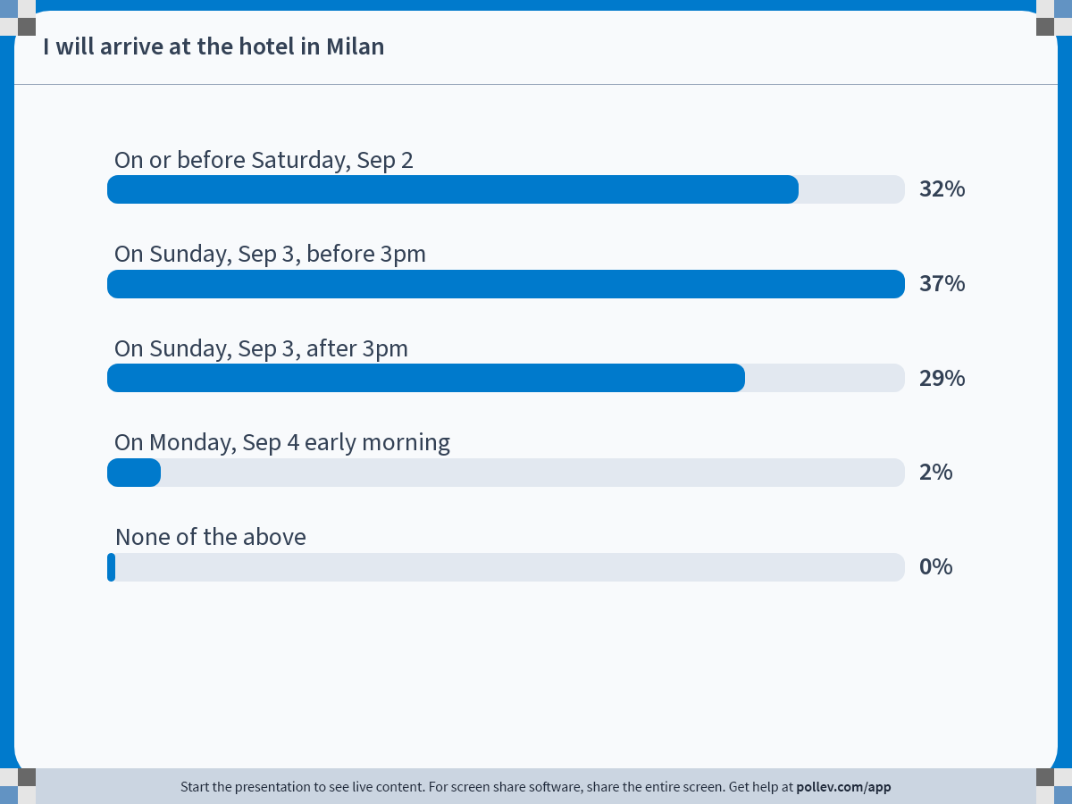
Notes:
Poll Title: Do not modify the notes in this section to avoid tampering with the Poll Everywhere activity. More info at polleverywhere.com/support I will arrive at the hotel in Milan https://www.polleverywhere.com/multiple_choice_polls/W48aUoQdkorGN8CDnd6ue?state=opened&flow=Default&onscreen=persist

Slide 5
Italy IBR · Presentations and Debates
Presentations and Debates
International Business Residential – Italy
5
Notes:
Now over to you. 9 groups present, in the order on the next slide.

Slide 6
Italy IBR · Presentations and Debates
Today’s Line-Up – 9 Presentations
1
Italy and the EU / the Euro
Debate · Groups 1 & 3
2
Kering
Company · Group 2
3
Italy’s Future in Tech and AI
Debate · Groups 4 & 7
4
Prada Group
Company · Group 5
5
Inter Milan FC
Company · Group 6
6
Pirelli
Company · Group 8
7
EssilorLuxottica
Company · Group 9
International Business Residential – Italy
6
Notes:
This is the running order, and it follows the group numbers from the sign-up sheet. 9 groups present across 7 slots: 2 of the slots are head-to-head debates, where two groups argue opposite sides of the same question, and 5 are company presentations. Each company group introduces the firm and then makes the case for or against investing in it.

Slide 7
Italy IBR · Broad-Topic Debates
Italy and the EU / the Euro
CONTRA · Group 1
PRO · Group 3
“Italy would be economically better off outside the EU, without the Euro”
“Being in the EU and using the Euro is good for Italy from an economic standpoint”
2 – 3 min executive summary from each side, then open debate
International Business Residential – Italy
7
Notes:
This is a head-to-head debate: the two groups were handed opposite sides of the same question, so treat the statements on the slide as positions to argue, not as my view. Group 1 opens with a 2 to 3 minute executive summary, Group 3 follows, and then we open the floor. Listen for which side leans on evidence and which leans on assertion.

Slide 8

Italy IBR · Company Presentations
Kering – A Portfolio of Iconic Luxury Houses
Your brief
Introduce the company
Then argue why (not) to invest in it
We visit them on the trip
Wednesday 9 Sep · 09.00 – 10.30
A session with a senior leader at one of the world’s most powerful luxury conglomerates, exploring how Kering builds and manages a portfolio of iconic houses.
Luxury Group
Group 2
International Business Residential – Italy
8
Notes:
Kering is on the trip: we see them Wednesday 9 Sep, 09.00 – 10.30. The group has 2 to 3 minutes to introduce the company and then to argue why we should, or should not, invest in it. Keep the investment case concrete, and note the questions you want to put to the company when we are in the room with them. Sector: Luxury Group. [Logo: Wikimedia Commons, File:Kering-logo.svg]

Slide 9
Italy IBR · Broad-Topic Debates
Italy’s Future in Tech and AI
PRO · Group 4
CONTRA · Group 7
“Italy is already on a good path”
“Italy is lagging far behind on tech and AI”
2 – 3 min executive summary from each side, then open debate
International Business Residential – Italy
9
Notes:
This is a head-to-head debate: the two groups were handed opposite sides of the same question, so treat the statements on the slide as positions to argue, not as my view. Group 4 opens with a 2 to 3 minute executive summary, Group 7 follows, and then we open the floor. Listen for which side leans on evidence and which leans on assertion.

Slide 10

Italy IBR · Company Presentations
Prada Group – Global Strategy in Luxury Fashion
Your brief
Introduce the company
Then argue why (not) to invest in it
We visit them on the trip
Tuesday 8 Sep · 15.00 – 16.30
Visit to the company’s headquarters for a session with a senior leader to explore how a global luxury brand approaches global strategy.
Luxury Fashion
Group 5
International Business Residential – Italy
10
Notes:
Prada Group is on the trip: we see them Tuesday 8 Sep, 15.00 – 16.30. The group has 2 to 3 minutes to introduce the company and then to argue why we should, or should not, invest in it. Keep the investment case concrete, and note the questions you want to put to the company when we are in the room with them. Sector: Luxury Fashion. [Logo: Wikimedia Commons, File:Prada Group - logo (Italy).svg]

Slide 11

Italy IBR · Company Presentations
Inter Milan FC – A Football Club as a Global Business
Your brief
Introduce the company
Then argue why (not) to invest in it
We visit them on the trip
Wednesday 9 Sep · 15.00 – 16.30
Explore how Inter operates as a global sports organization and how its brand and commercial strategy drives success on and off the pitch.
Iconic Sports Team
Group 6
International Business Residential – Italy
11
Notes:
Inter Milan FC is on the trip: we see them Wednesday 9 Sep, 15.00 – 16.30. The group has 2 to 3 minutes to introduce the company and then to argue why we should, or should not, invest in it. Keep the investment case concrete, and note the questions you want to put to the company when we are in the room with them. Sector: Iconic Sports Team. [Logo: Wikimedia Commons, File:FC Internazionale Milano 2021.svg]

Slide 12

Italy IBR · Company Presentations
Pirelli – R&D and Innovation Behind the Tire
Your brief
Introduce the company
Then argue why (not) to invest in it
We visit them on the trip
Tuesday 8 Sep · 09.00 – 10.45
A session with the CTO of a global leader in tire manufacturing, exploring how R&D and innovation drive commercial strategy across motorsport and luxury markets.
Vehicle Manufacturing
Group 8
International Business Residential – Italy
12
Notes:
Pirelli is on the trip: we see them Tuesday 8 Sep, 09.00 – 10.45. The group has 2 to 3 minutes to introduce the company and then to argue why we should, or should not, invest in it. Keep the investment case concrete, and note the questions you want to put to the company when we are in the room with them. Sector: Vehicle Manufacturing. [Logo: Wikimedia Commons, File:Pirelli - logo full (Italy, 1997).svg]

Slide 13

Italy IBR · Company Presentations
EssilorLuxottica – Premium Eyewear at Global Scale
Your brief
Introduce the company
Then argue why (not) to invest in it
We visit them on the trip
Tuesday 8 Sep · 11.30 – 13.00
Hear from a global leader in premium eyewear design and manufacturing, to learn how the company partners with top fashion brands.
Eyewear Manufacturer
Group 9
International Business Residential – Italy
13
Notes:
EssilorLuxottica is on the trip: we see them Tuesday 8 Sep, 11.30 – 13.00. The group has 2 to 3 minutes to introduce the company and then to argue why we should, or should not, invest in it. Keep the investment case concrete, and note the questions you want to put to the company when we are in the room with them. Sector: Eyewear Manufacturer. [Logo: Wikimedia Commons, File:Logo EssilorLuxottica.svg]

Slide 14
Thank You!
Notes:
Thank you all. See you in Milan on September 6, and we will regroup on Zoom on October 4 to debrief.

Slide 15
Italy IBR · Backup Slides
Backup Slides
International Business Residential – Italy
15

Slide 16
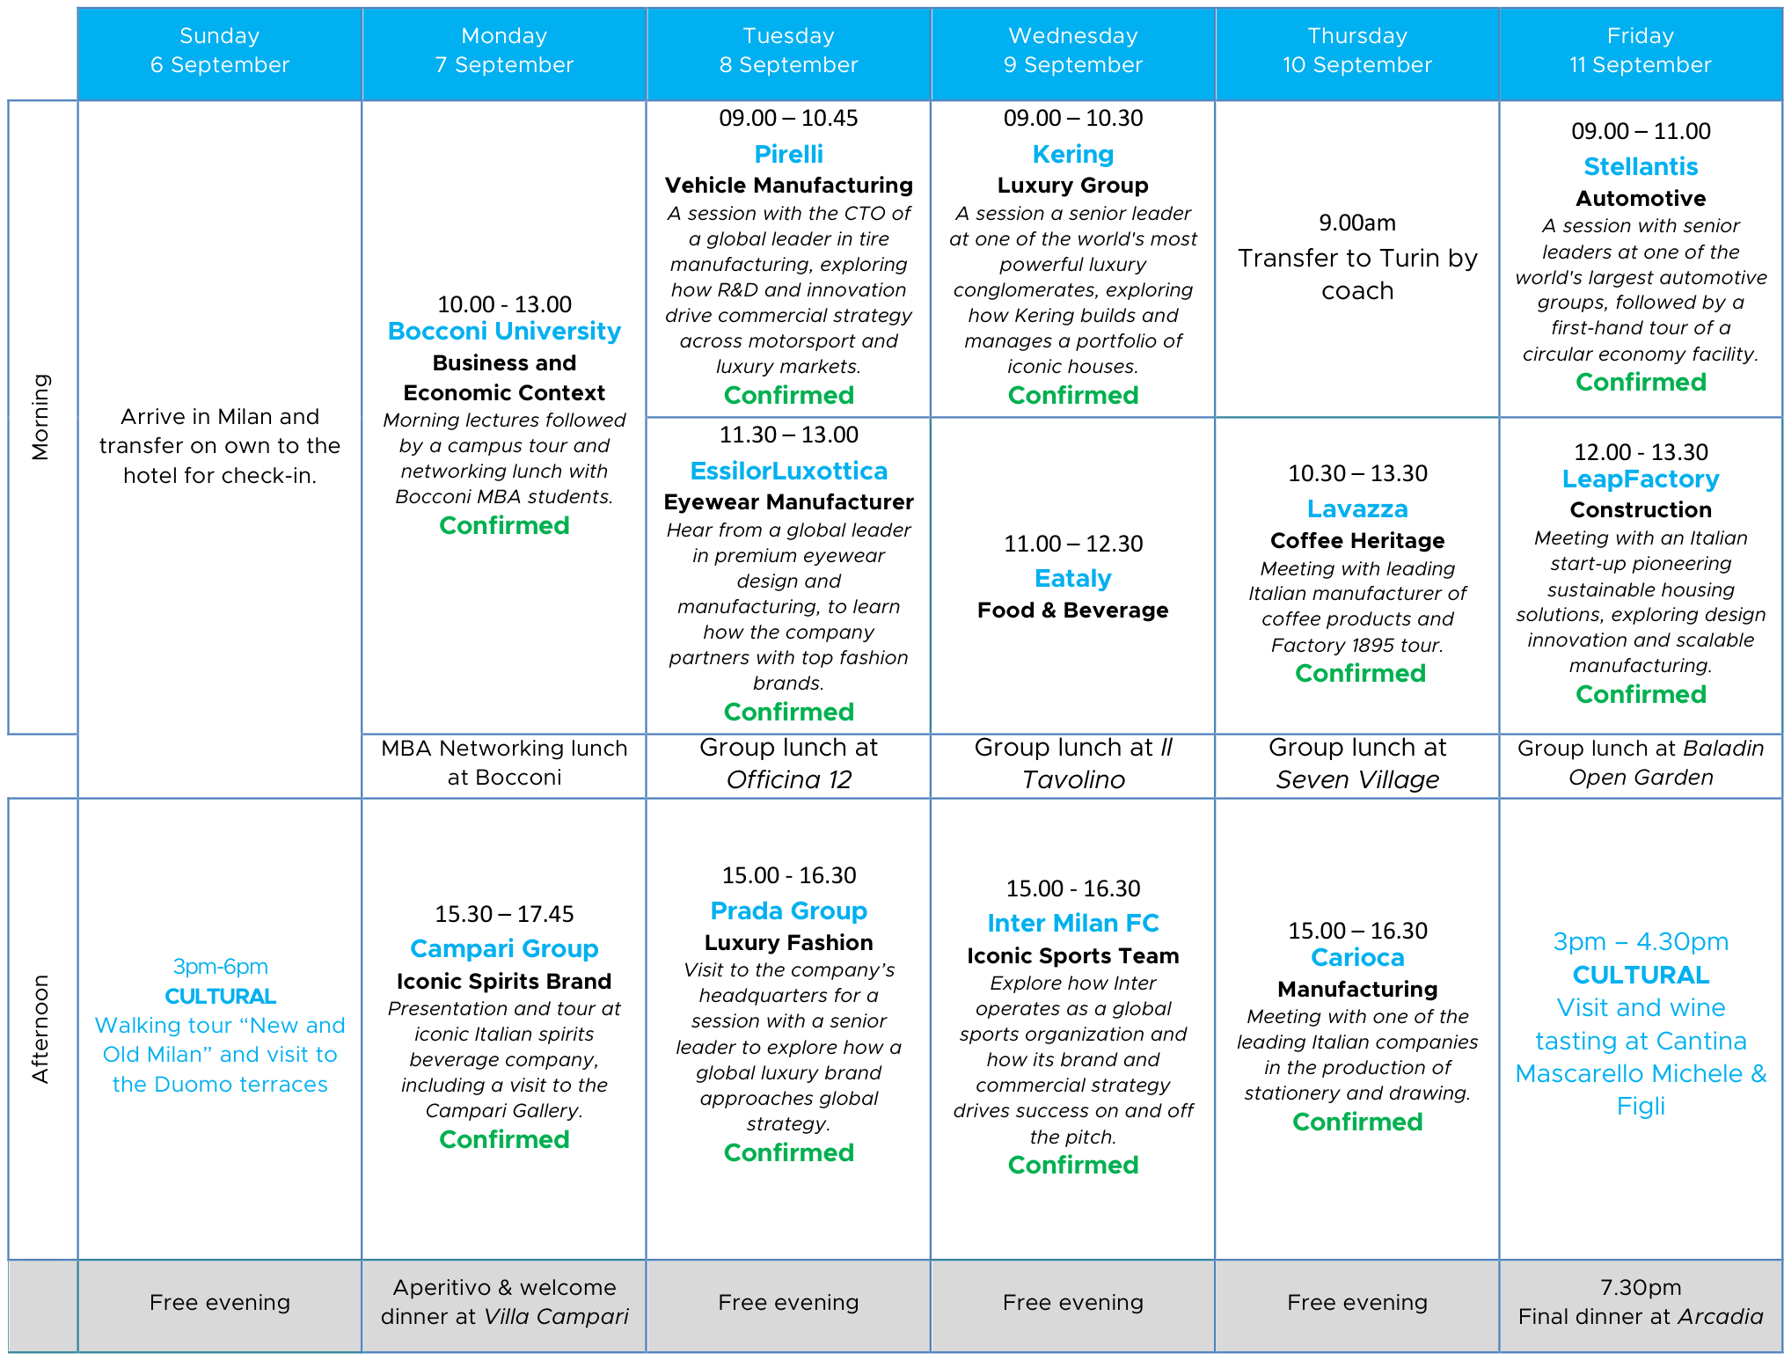
Italy IBR · Backup
Trip Schedule (Sep 6 – 11)
← Back
Itinerary: Legacy Ventures, “UCLA Italy 2026”
International Business Residential – Italy
16
Notes:
This is the full week, Sunday the 6th through Friday the 11th. Milan Sunday through Wednesday, then we coach over to Turin on Thursday morning. The company sessions are the ones 5 of the groups are presenting on today: Pirelli and EssilorLuxottica and Prada on Tuesday, Kering and Inter on Wednesday, then Lavazza and Carioca in Turin, and Stellantis and LeapFactory on Friday. Bocconi opens the week on Monday morning, and the Wednesday late-morning slot is Eataly.

